Slide 1
Speech Recognition Project
By Yuxuan Yao, Yuan Liu, Kuiyu Zhu, Guiming Xu

Slide 2
Introduction

Slide 3
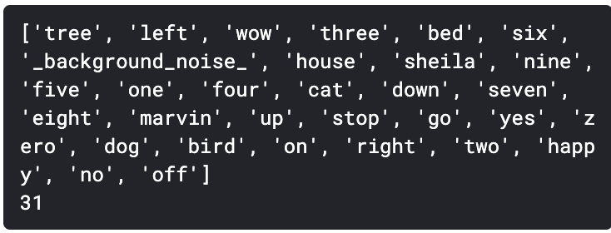
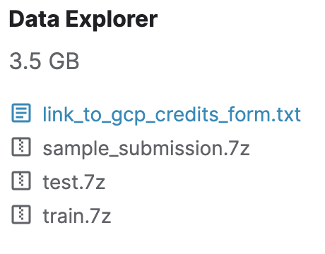

Data Intro
TensorFlow Speech Recognition Challenge
Link: https://www.kaggle.com/c/tensorflow-speech-recognition-challenge
Different Labels:
Dataset Size:
train.7z - Contains a few informational files and a folder of audio files with labels like ‘yes’, ‘no’, ‘up’, ‘down’, ‘left’...
test.7z - Contains an audio folder with 150,000+ audio files without labels.
sample_submission.csv -A sample submission file in the correct format.

Slide 4
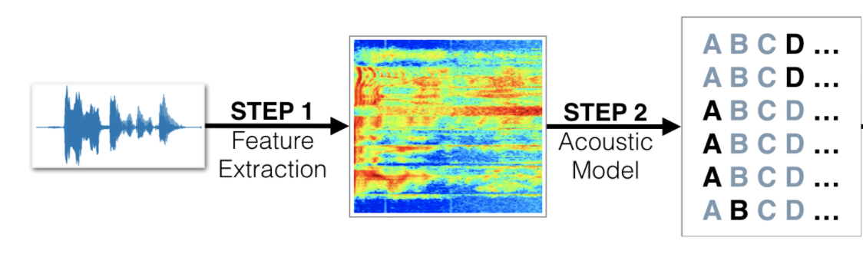
Our Goal
Try different models and compare the results
Use models to do prediction and speech recognition
Our goal is to classify speech by establishing and comparing multiple deep learning models, and finally select the model with the highest accuracy.

Slide 5
Data Exploration

Slide 6
Visualization
Bar Plots
Spectogram
Mel Power Spectogram
MFCC
...

Slide 7
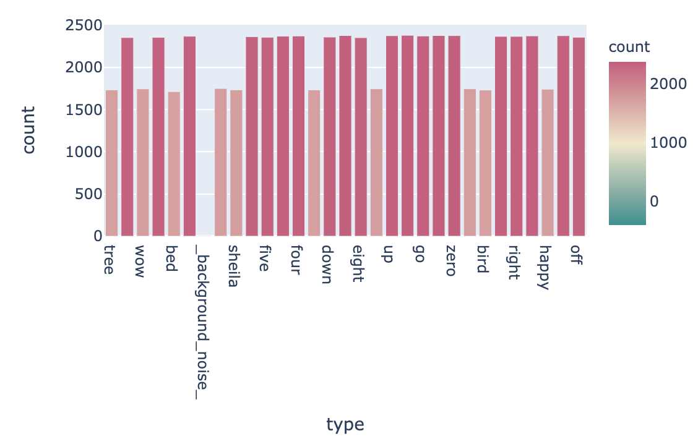
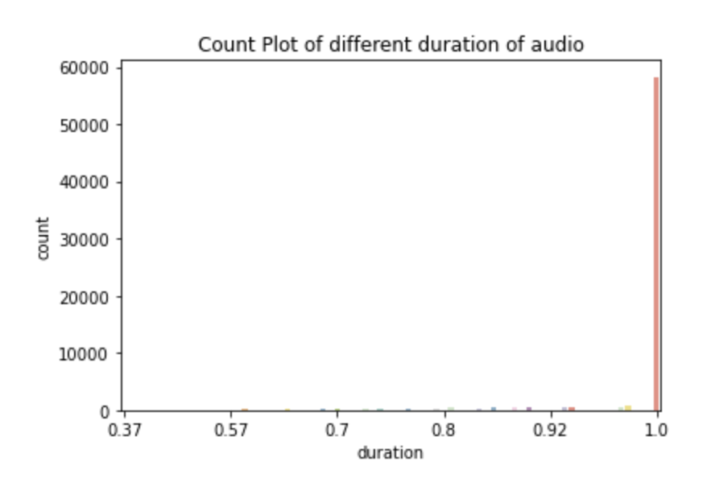
Right:
Count of Duration in the data set
Left:
Count of each label

Slide 8
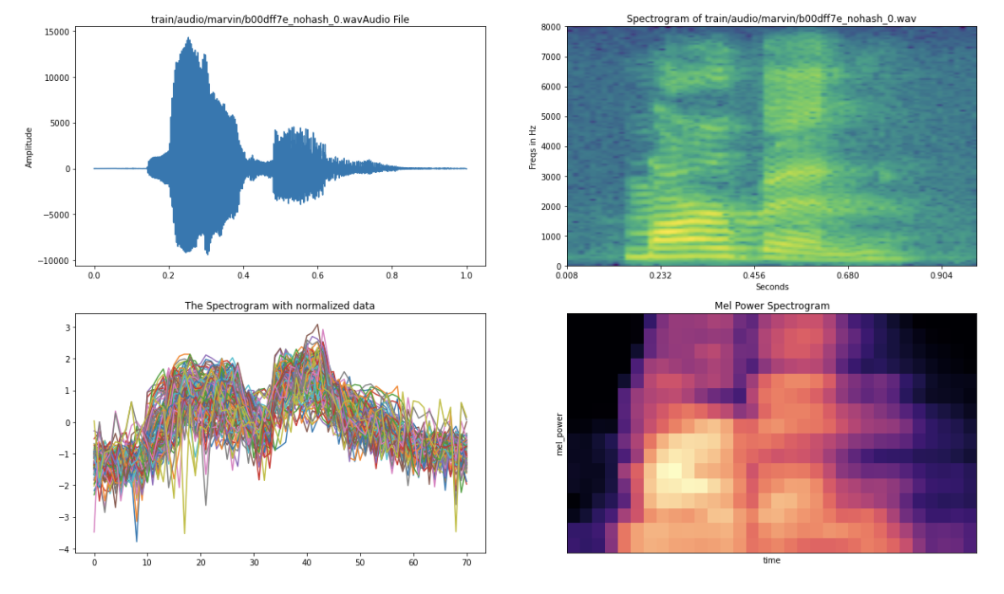
Amplitude Plot
Normalized Amplitude Plot
Spectogram
Mel
Power
Spectogram

Slide 9
Data Preprocessing

Slide 10
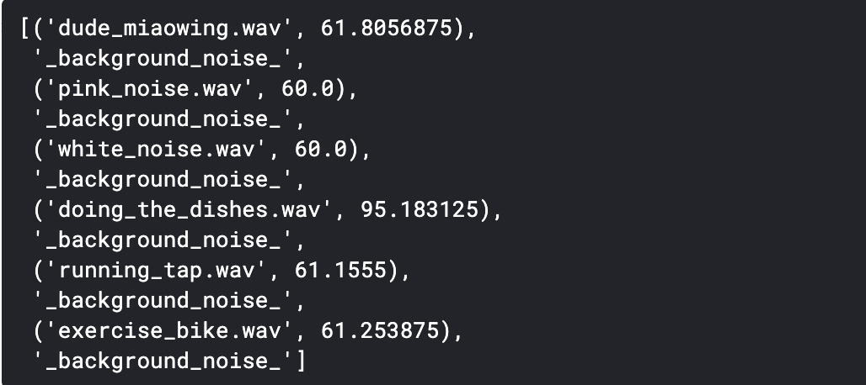
Outliers

Slide 11
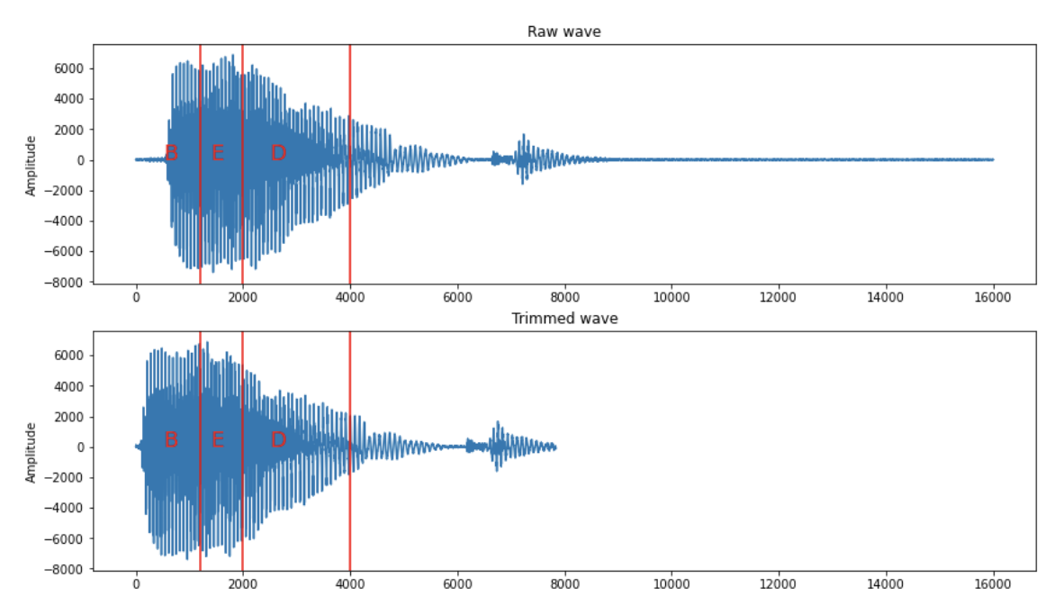
Duration(Trim/Pad/Chop)

Slide 12
Modeling

Slide 13
Related packages
SoundFile: SoundFile is an audio library based on libsndfile, CFFI and NumPy.
Librosa: A python package for music and audio analysis. It provides the building blocks necessary to create music information retrieval systems.
Other processing work
As data processing mentioned before, we unify the duration of audio files.
We also do the downsampling work. The advantage of downsampling is that it reduces the number of data points, which means less computation time.
Generally, these packages help us convert audio files into arrays and downsampling for easily modeling and analysis.
Notes:
There are two audio related packages, SoundFile and Librosa. They convert audio files into arrays.
And we also do other processing like downsampling, which can reduces computation time.
Generally, we hope our modeling work easier.

Slide 14
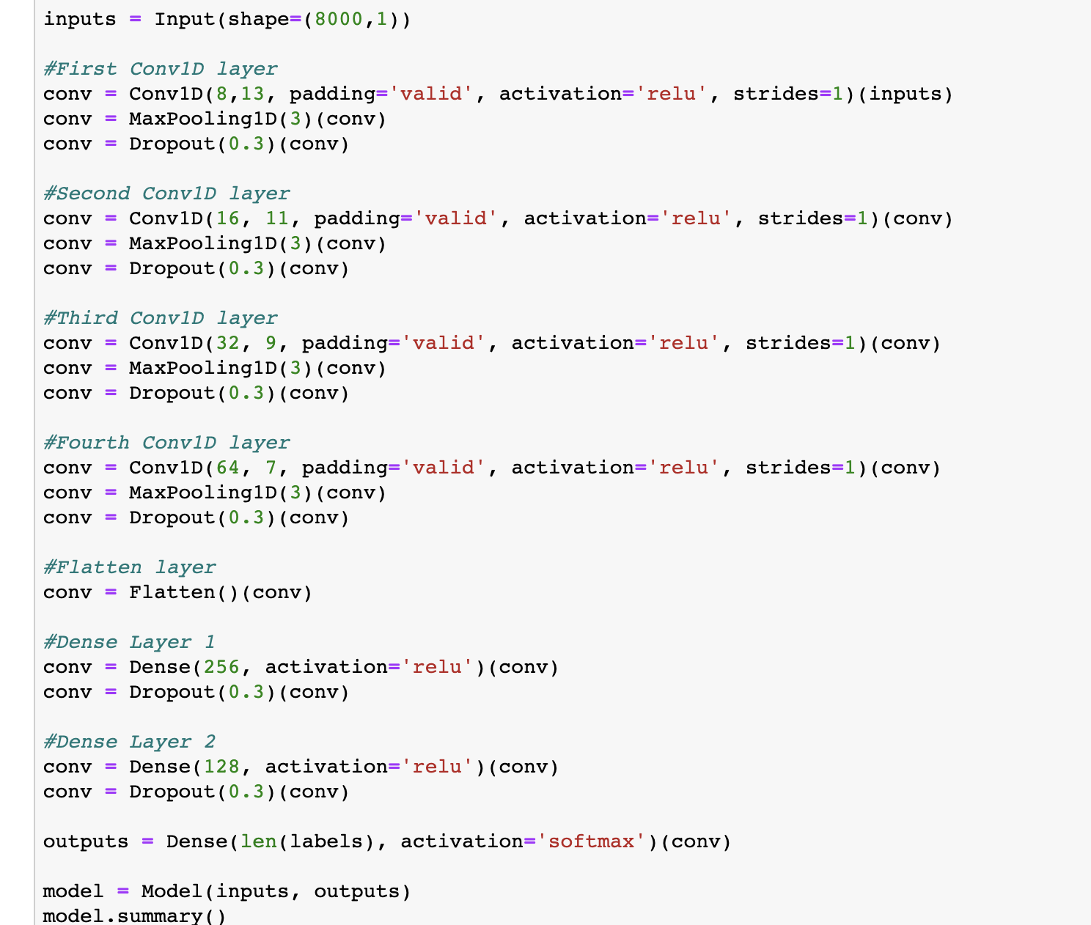
CNN Modeling
Conv1D and MaxPooling1D: 1 dimensional arrays due to audio files.
Dense: connect to entire neural network
Flattening: convert 1D arrays into a single long continuous linear vector
Dropout: regularization randomly set some of the dimensions of input vector to be zero
Notes:
Tn we start our CNN modeling part.
We have 1 dimensional arrays due to audio files, and we have 4 convolutional layers, 1 flatten layer, 2 dense layers.
The do same process we learned in the course.

Slide 15
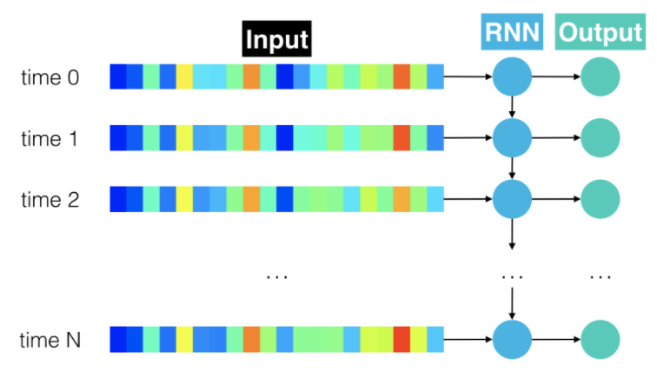
RNN Modeling(Embedding/Dense/Dropout)

Slide 16
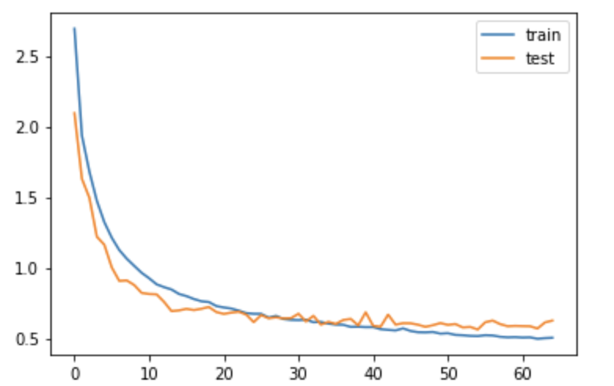
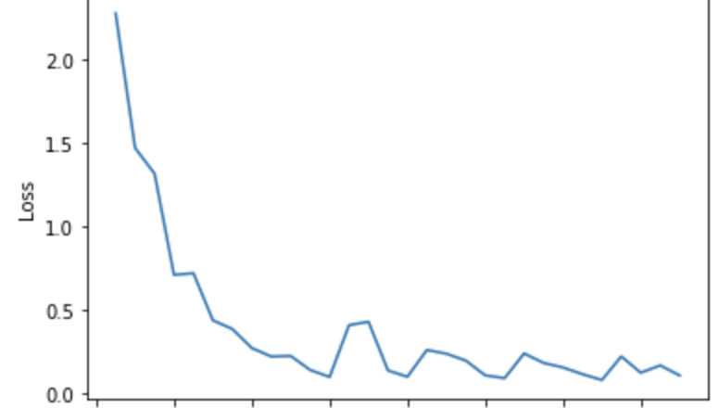
Prediction Result (CNN)
Plot loss and val loss
Model accuracy: CNN:81.6% RNN: 85.9%
Random Forest: 72.2%
322/322 [==============================] - 5s 14ms/step - loss: 0.6253 - accuracy: 0.8164
The test score: [0.6252769827842712, 0.816378116607666]
Notes:
For now, we only get the results from CNN model, here is the plot and our model accuracy is 81.6%.

Slide 17
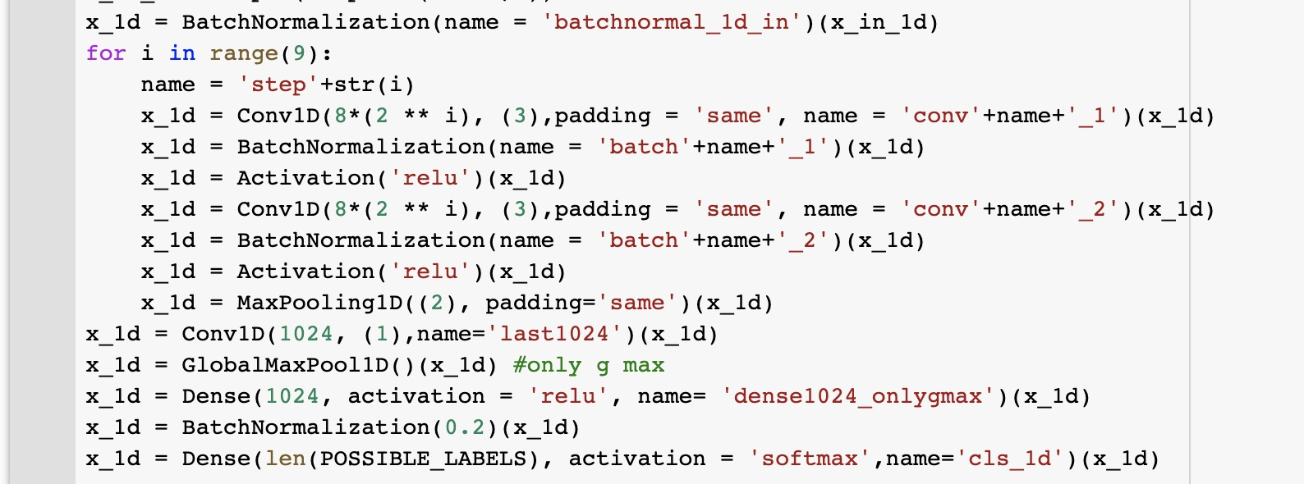
We will also try another CNN & LSTM …

Slide 18
Thank You!

